Slide 1
Eye-Tracking Classification
Fall 2021 Group 16
Chang Zeng
Kai Ye
Xuming Deng

Slide 2
Previous Goal:Purpose of Eye-Tracking Classification
As programmers, we spend too much time coding ,reading documents and learning different strategy on YouTube. We want to build an application that can classify activities (coding, reading ,watching video) we are doing everyday by using the front camera of our laptop or desktop.

Slide 3
Problem we facing
APIs accessibility
None-related software installation(Virtual Machine. etc)

Slide 4
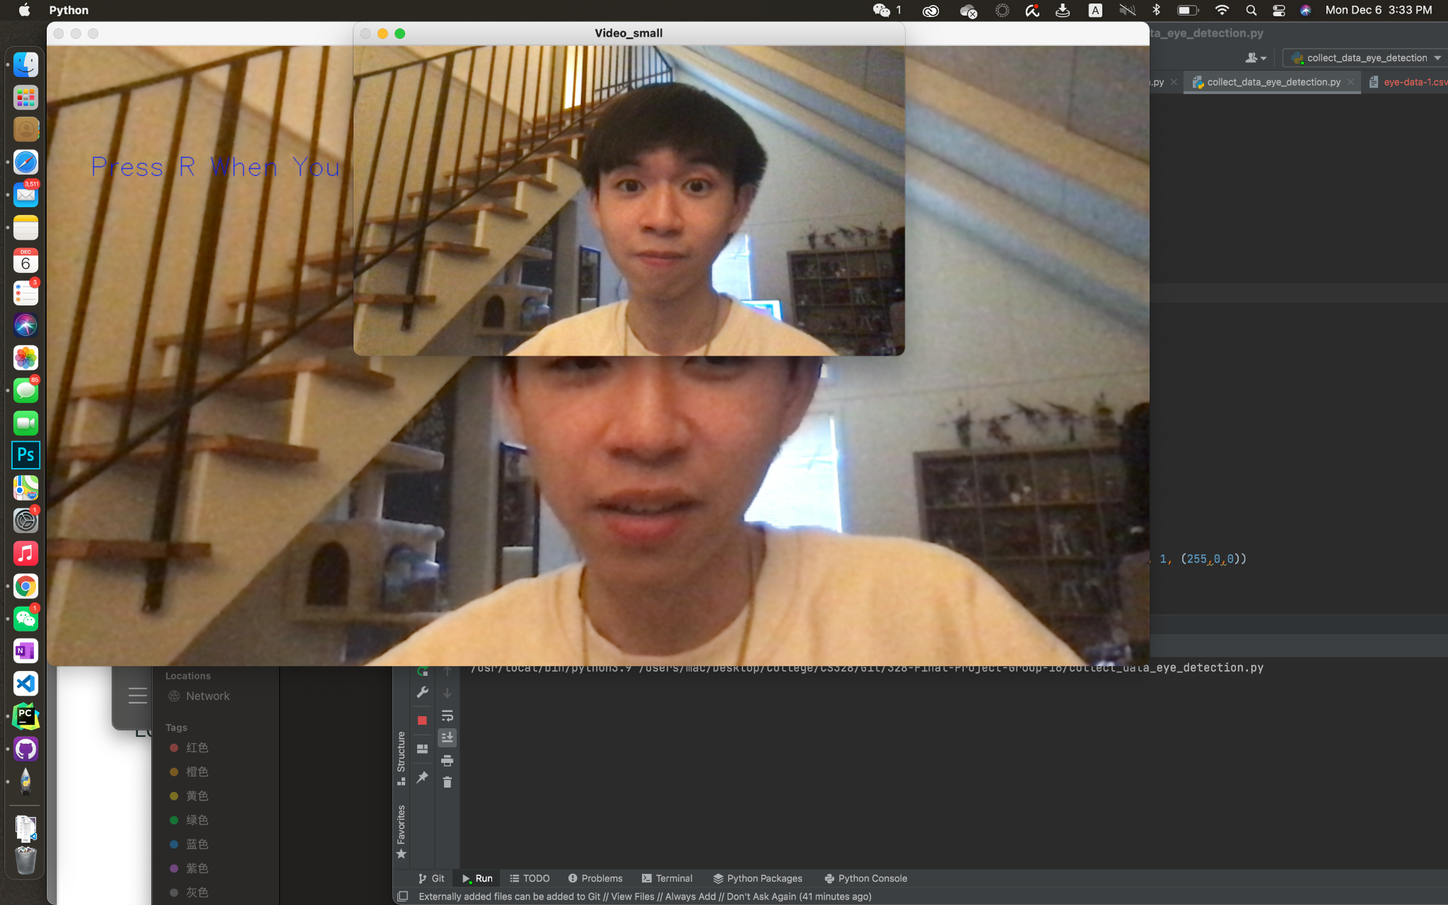
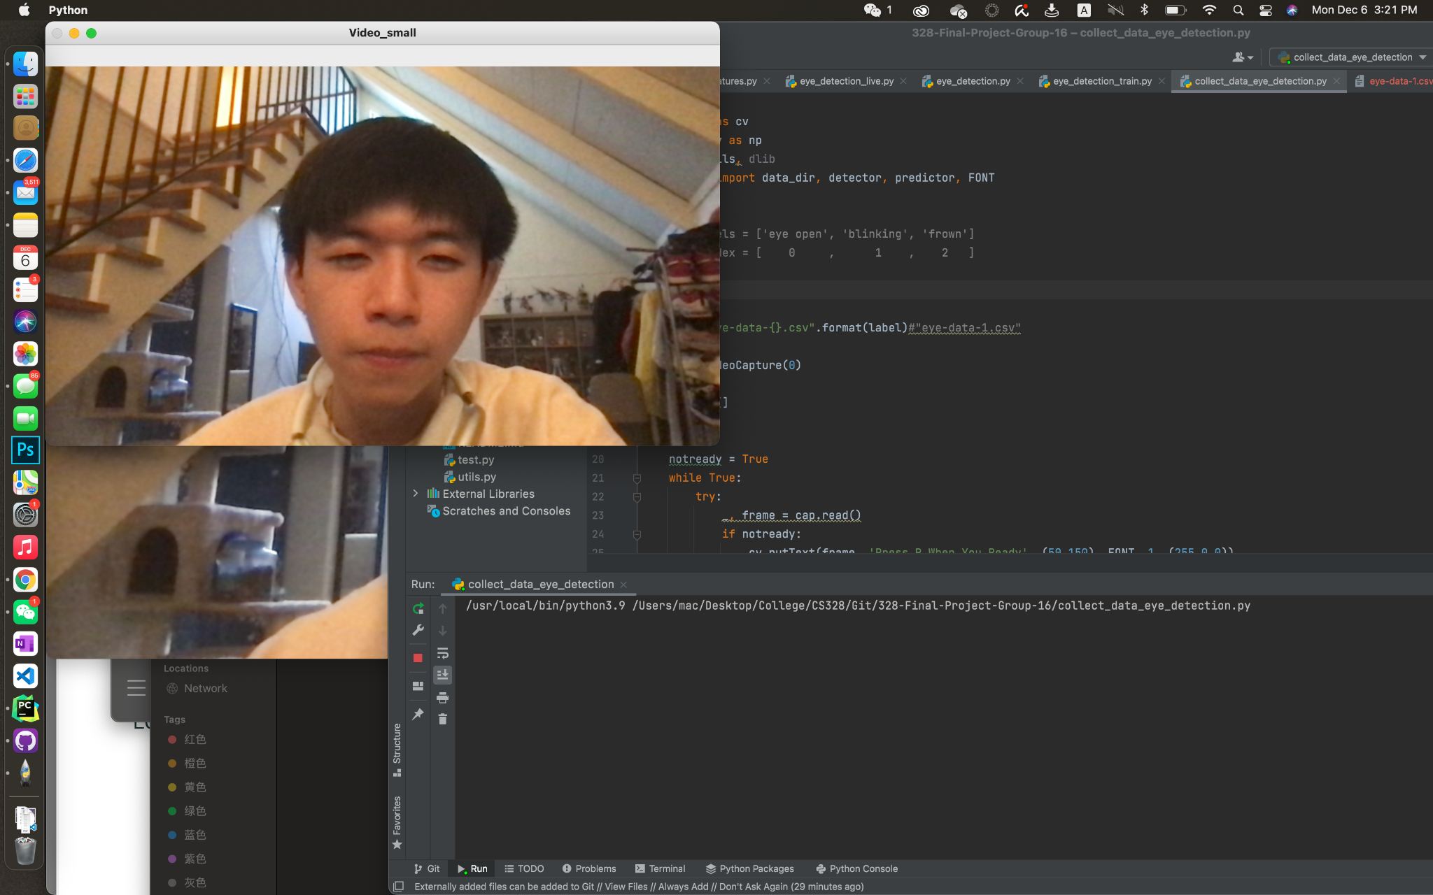
How we collect data

Slide 5
New Goal: Using eye-tracker to classify eye activities
Eye Open
Eye Close
Blinking
Staring
Frown

Slide 6

Model Selection and Data analysis
API
CV2 (openCV)
Features
Eyes vertical ratio among window
Eyes Ratio
Eyes Ratio Variance
etc
Classification
Decision Tree from Sklearn
cross-validation for accuracy
Notes:
We are using CV2 (openCV) as our eye points tracking API. Then use that API to get the the points x-axis and y -axis of our eye movement by doing different activities . Then, we use the different features(eye’s vertical ratio, eye’s horizontal rato, ratio of vertical length and horizontal ratio, etc.) to train a Decision Tree Classifier from Sklearn using a cross-validation strategy. We will try to collect data with the exact time of each activity to prevent overfitting. (Same Strategy as the homework)

Slide 7
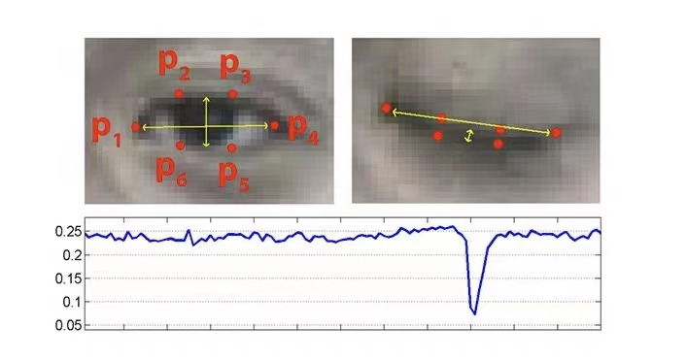
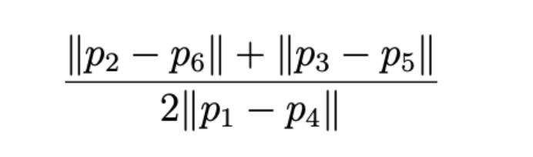
Feature: Eyes Aspect Ratio
Ratio =
Notes:
We are using CV2 (openCV) as our eye points tracking API. Then use that API to get the the points x-axis and y -axis of our eye movement by doing different activities . Then, we use the different features(eye’s vertical ratio, eye’s horizontal rato, ratio of vertical length and horizontal ratio, etc.) to train a Decision Tree Classifier from Sklearn using a cross-validation strategy. We will try to collect data with the exact time of each activity to prevent overfitting. (Same Strategy as the homework)

Slide 8
Progress
Created application to collect data by using webcam
Finished features implementation
Model training application is finished

Slide 9
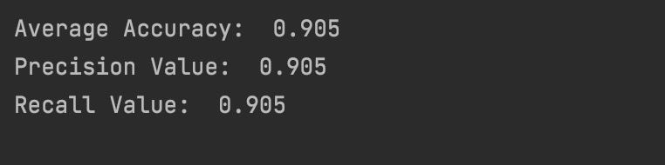
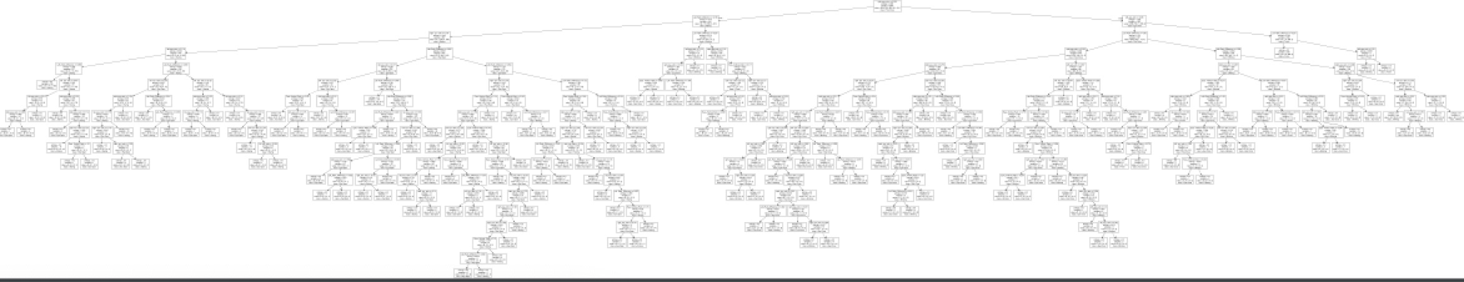
Decision Tree and Accuracy

Slide 10
Conclusion
Goal: Classify eye-movement activity
Label: Eye Open, Eye Close, Blinking, Frown, Staring
Model: Decision Tree
Data: Data collect by our own with even length of each activity
API Candidate: CV2(openCV)

Slide 11
Thanks for you time!
Question?

